Slide 1
CHORUS SEOUL 2017 LAAO LIVE I
Persistent Atrial Fibrillation Patient with Alcoholic Liver Cirrhosis and Cerebral Aneurysm
Nov. 04. 2017
Chung-Ang University Hospital
Cardiovascular & Arrhythmia Center
SEOUL, COREE

Slide 2
Brief Case Summary
Age / Sex: 71 / Male
C/C: Major bleeding during anticoagulation during VKA and Non-major bleeding during Dabigatran 110 mg bid
Past medical history
# Hypertension
# Alcoholic liver cirrhosis (Child A, Platelet 80,000/mL)
# s/p L-spine Fx. (NSAIDs)
# s/p Renal cell carcinoma (Rt. Partial nephrectomy)
# Dementia
CHA2DS2-VASc score = 2
HASBLED score = 5
Notes:
MRN: 00687089 (JYG)

Slide 3
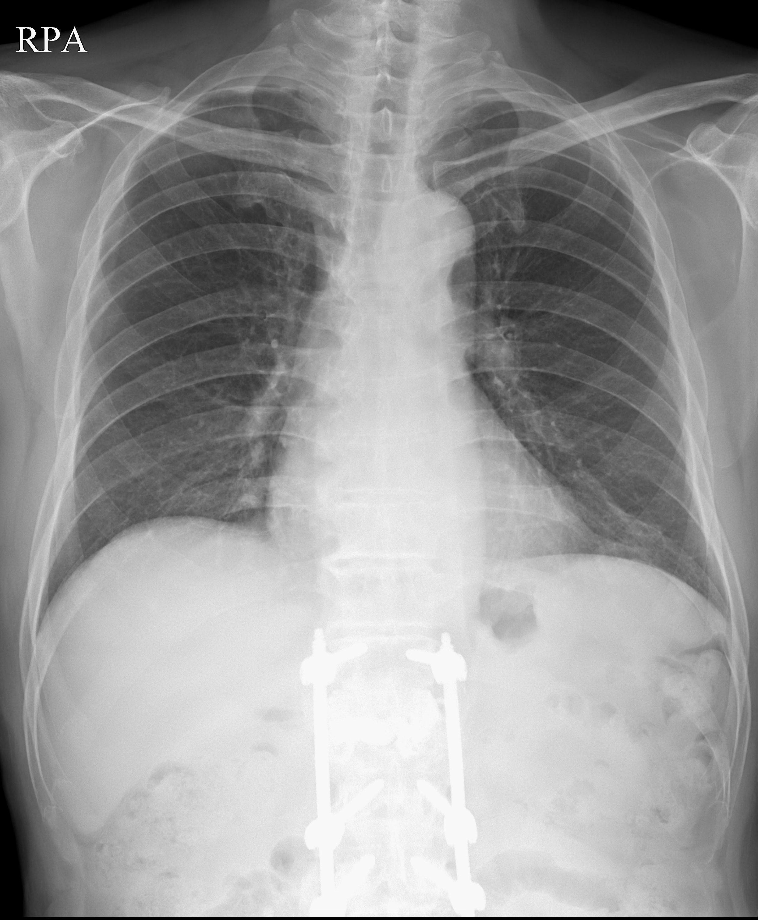
CHEST X-Ray

Slide 4
EKG
Atrial fibrillation (53 bpm)

Slide 5
Echocardiography
LA 51 mm, LVEF 51 %

Slide 6
Saccular Aneurysm

Slide 7
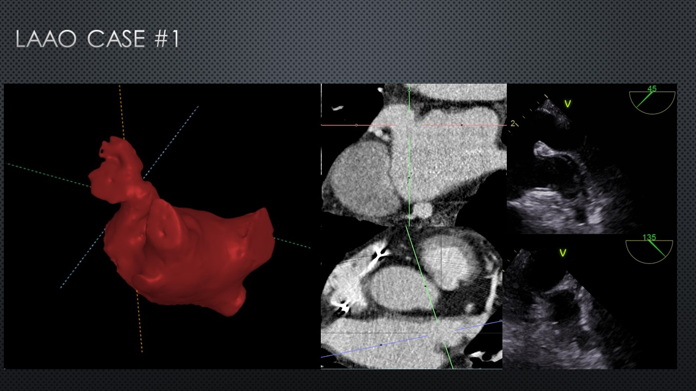
Cardiac CT

